Slide 1
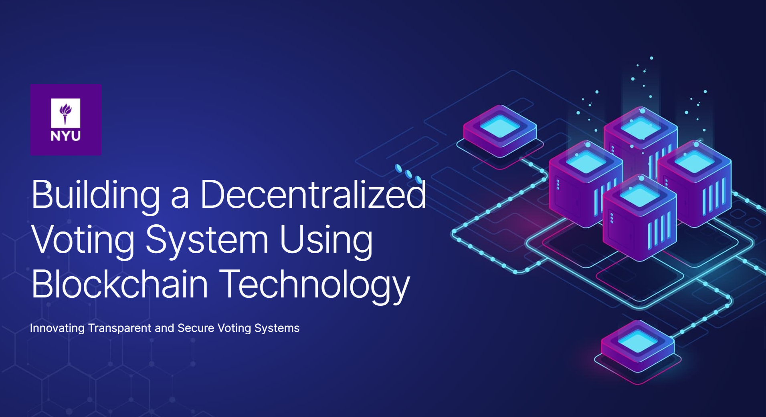
Shravya Vorugallu
SV2630

Slide 2
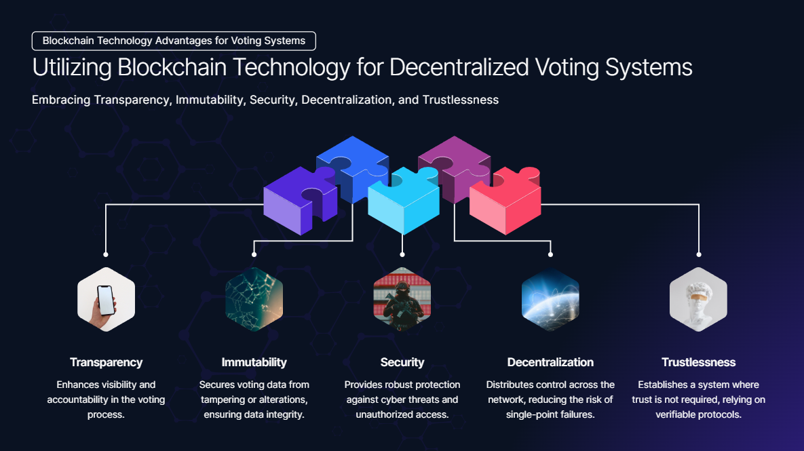

Slide 3
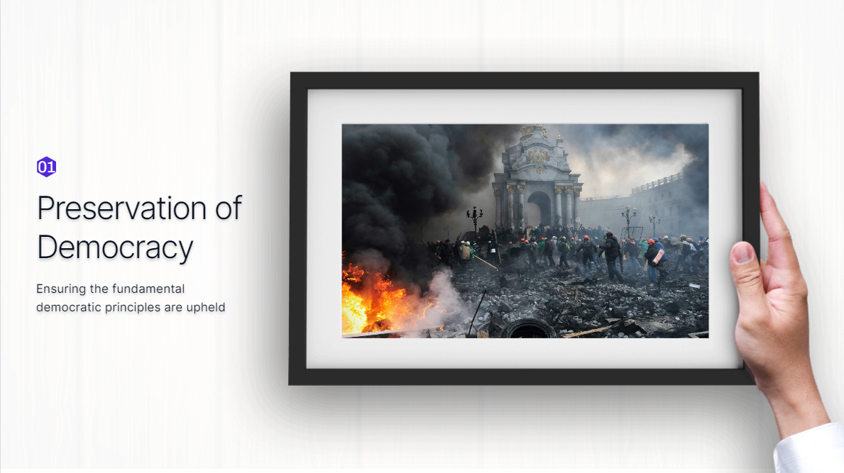

Slide 4
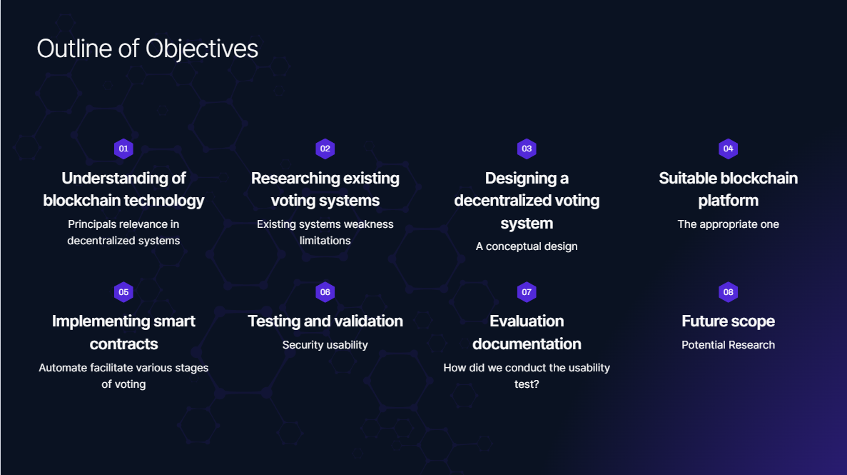

Slide 5
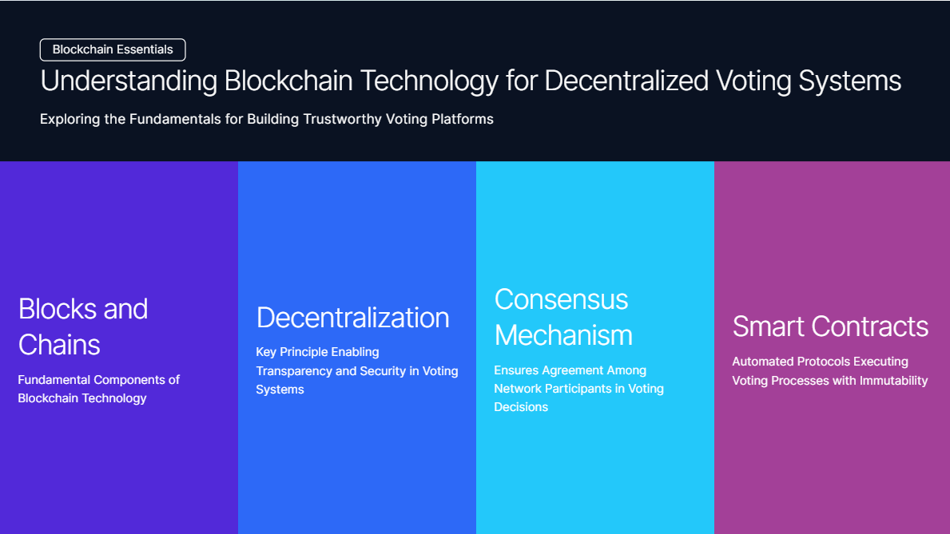

Slide 6
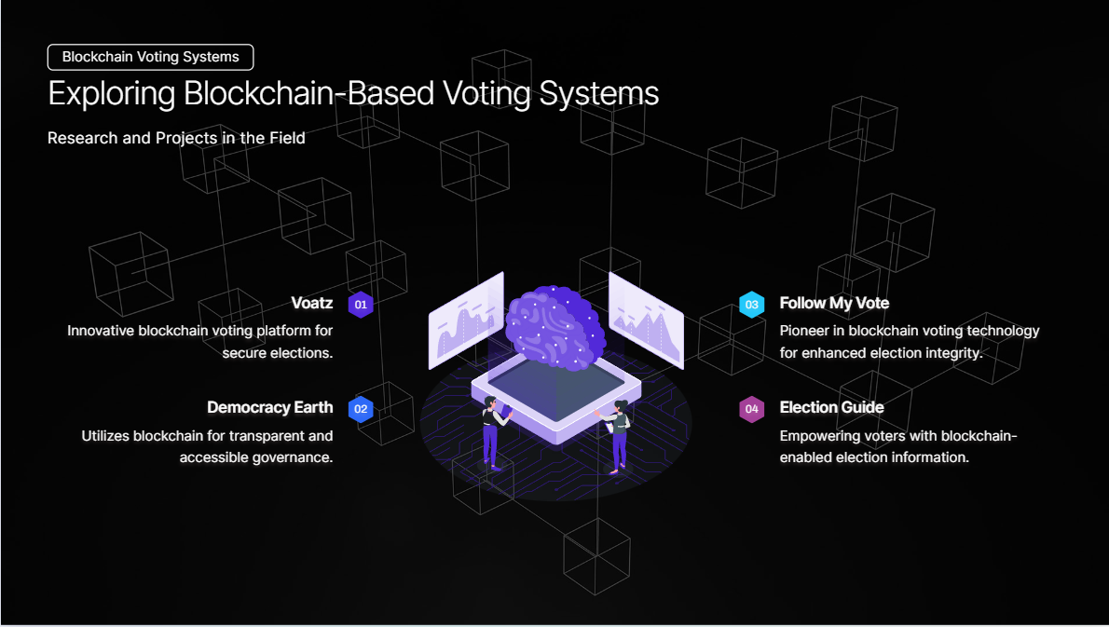

Slide 7
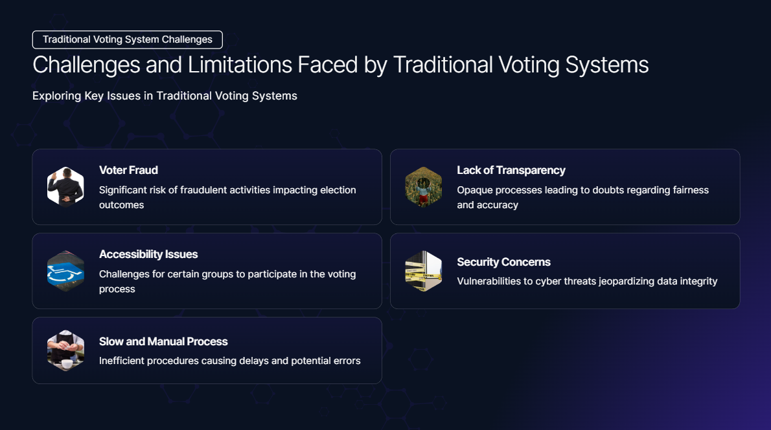

Slide 8
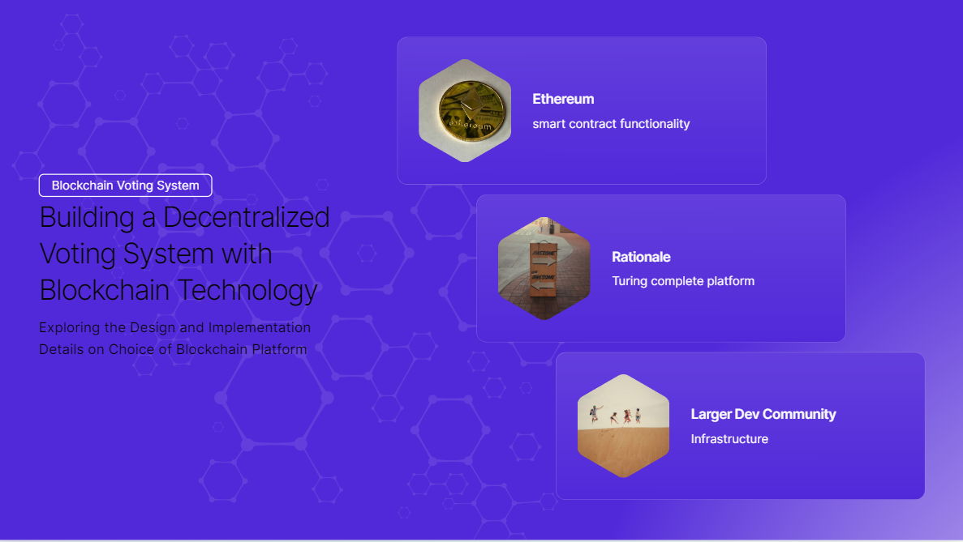

Slide 9
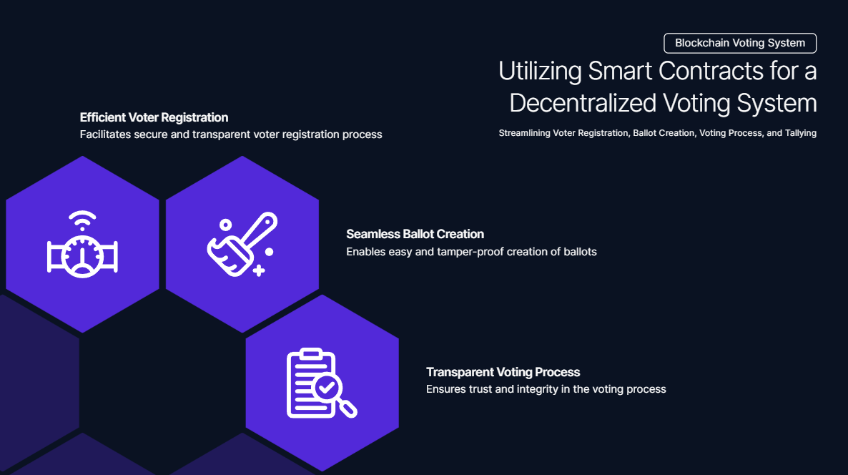

Slide 10
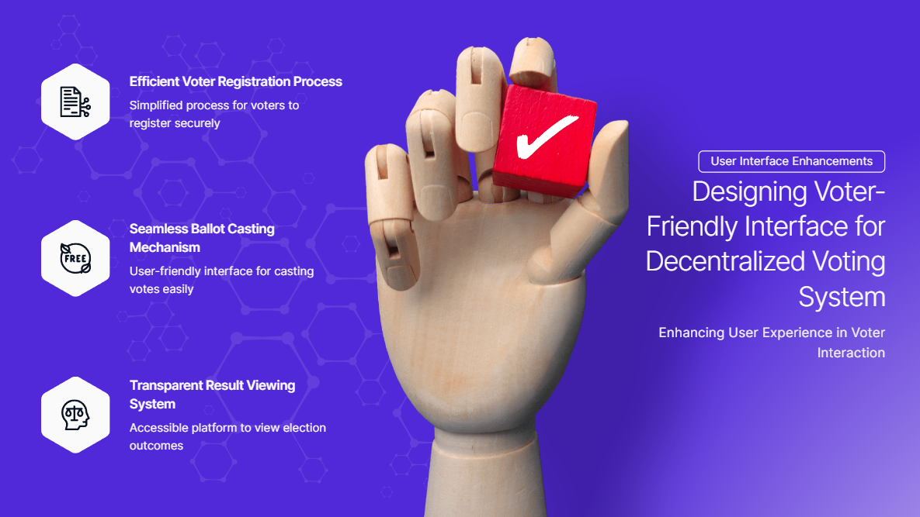

Slide 11
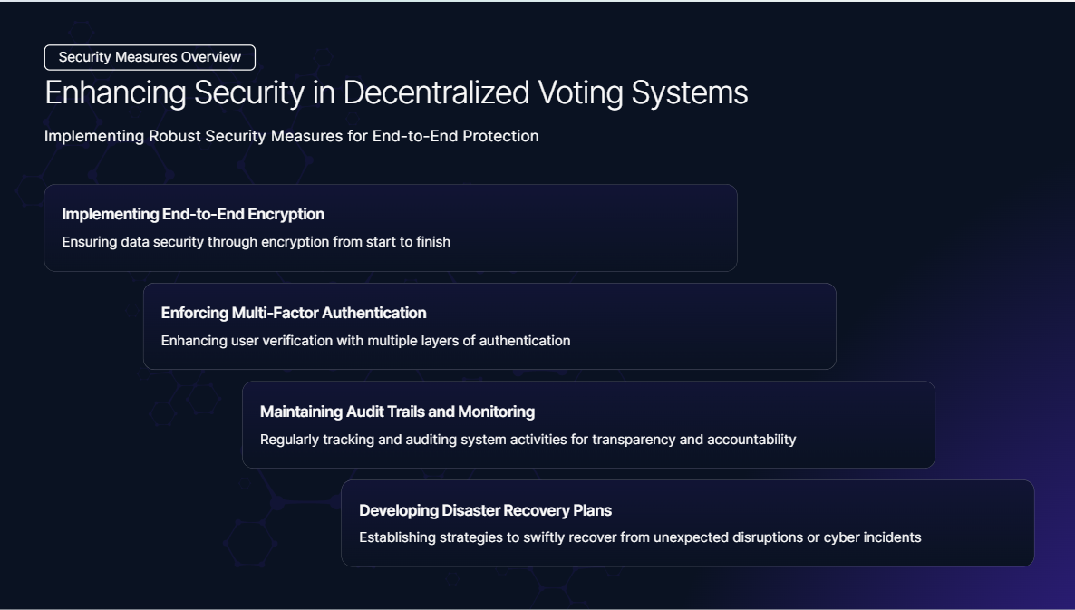

Slide 12
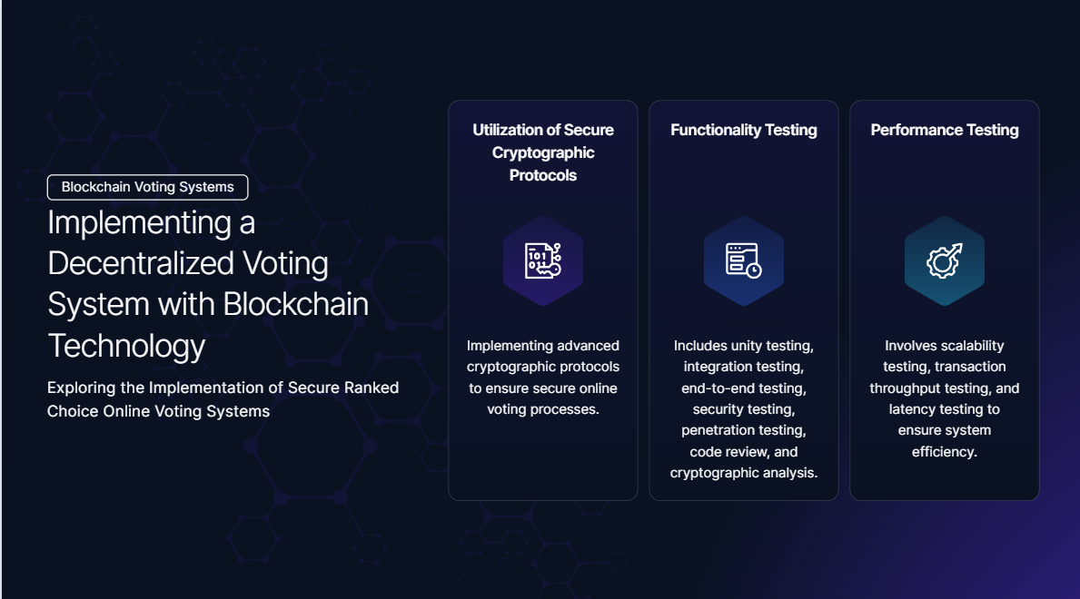

Slide 13
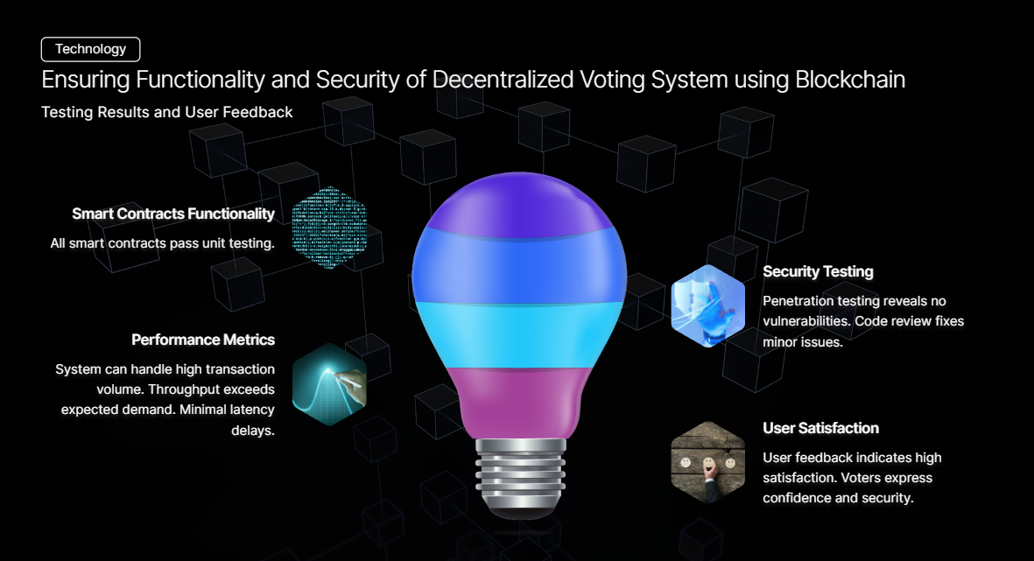

Slide 14
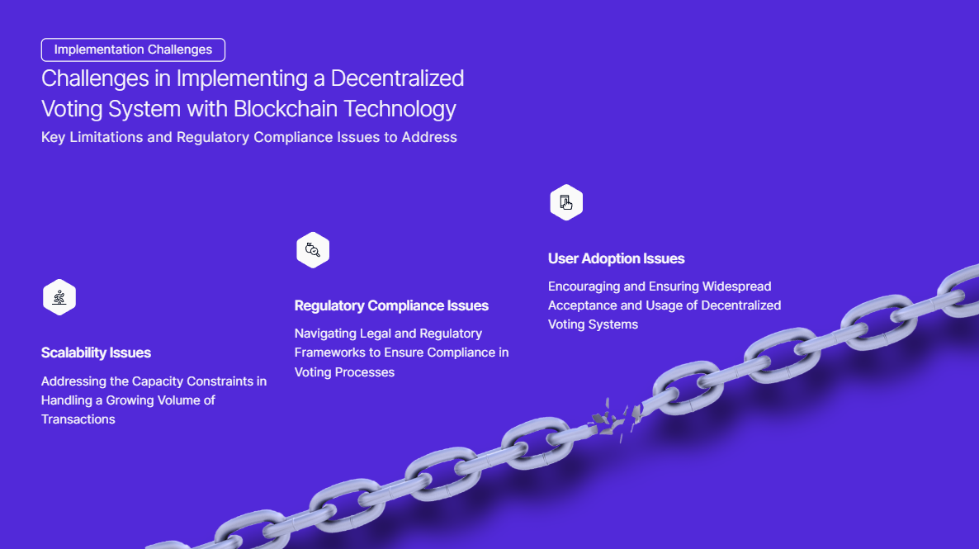

Slide 15
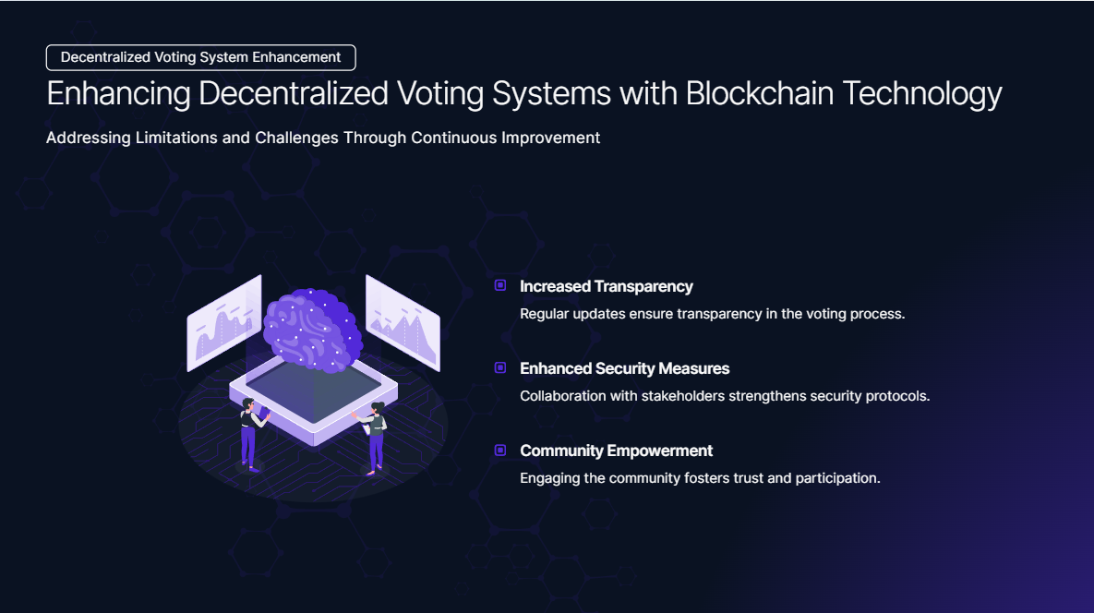

Slide 16
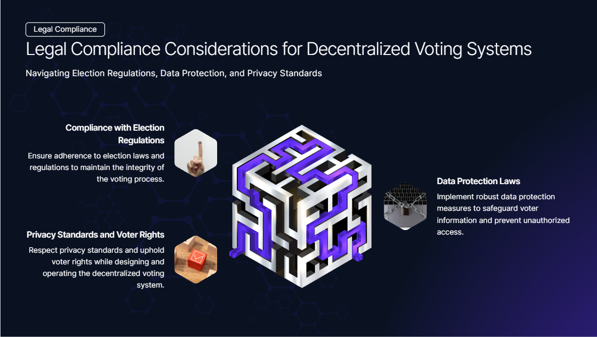

Slide 17
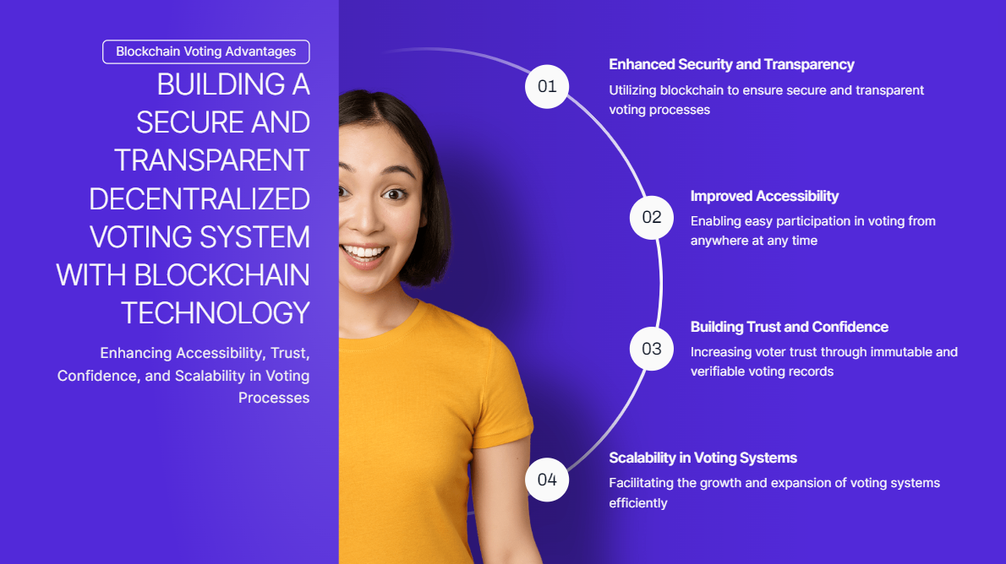

Slide 18
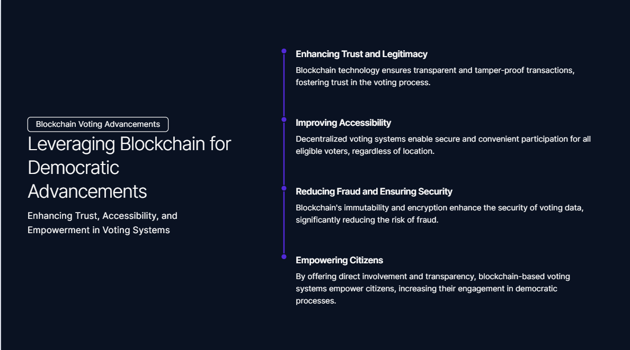

Slide 19
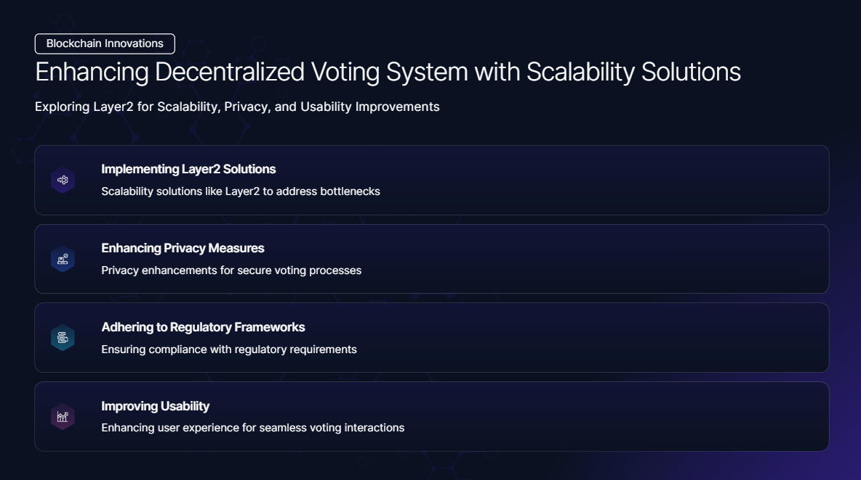

Slide 20
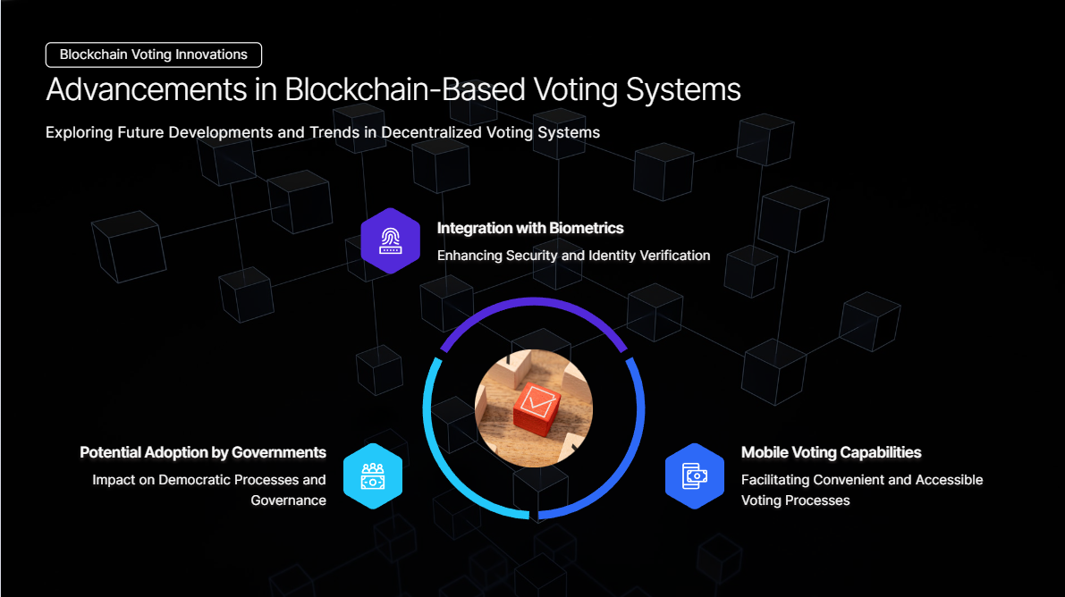

Slide 21
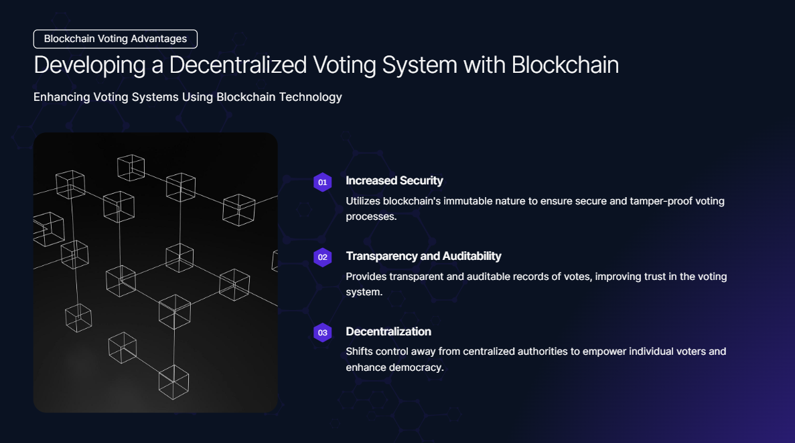

Slide 22
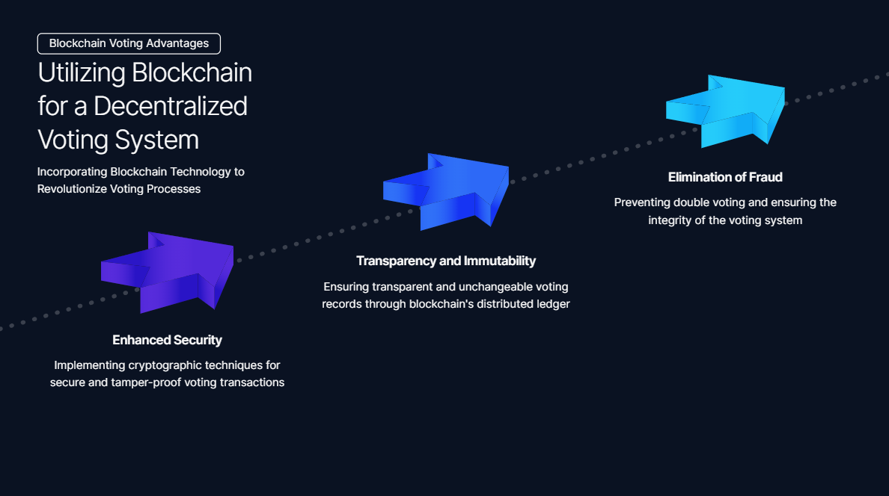

Slide 23
Citations
1. Nakamoto, S. (2008). Bitcoin: A peer-to-peer electronic cash system. https://bitcoin.org/bitcoin.pdf
2. Buterin, V. (2014). Ethereum: A Next-Generation Smart Contract and Decentralized Application Platform. https://ethereum.org/en/whitepaper/
3. Tapscott, D., & Tapscott, A. (2016). Blockchain revolution: how the technology behind bitcoin is changing money, business, and the world. Penguin.
4. Swan, M. (2015). Blockchain: Blueprint for a New Economy. O'Reilly Media.
5. Grigg, I. (2005). Triple Entry Accounting. https://nakamotoinstitute.org/triple-entry-accounting/
6. Voatz. (n.d.). Secure Mobile Voting and Citizen Engagement Platform. https://voatz.com/
7. Democracy Earth. (n.d.). Sovereign. https://www.democracy.earth/
8. Follow My Vote. (n.d.). Follow My Vote. https://followmyvote.com/
9. Microsoft. (n.d.). ElectionGuard. https://www.microsoft.com/en-us/research/project/electionguard/
10. King, R. (2020). Blockchain Voting Systems: Challenges and Opportunities. Journal of Elections, Public Opinion & Parties, 1-21. doi:10.1080/17457289.2020.1759203
11. Smith, J. (2018). The Future of Voting: Blockchain Voting.
https://www.magnachain.co/news/the-future-of-voting-blockchain-voting

Slide 24
Citations
12. European Parliament. (2019). Using blockchain technology for e-voting. https://www.europarl.europa.eu/RegData/etudes/IDAN/2019/631060/IPOL_IDA(2019)631060_EN.pdf
13. World Economic Forum. (2018). Building Block(chain)s for a Better Planet. http://www3.weforum.org/docs/WEF_White_Paper_Blockchain_for_Sustainable_Development_2018.pdf
14. National Institute of Standards and Technology. (2020). Blockchain Technology Overview. https://csrc.nist.gov/publications/detail/white-paper/2020/10/15/blockchain-technology-overview/draft
15. American Bar Association. (2018). Blockchain Voting: Can Democracy be Hacked?. https://www.americanbar.org/groups/business_law/publications/committees/newsletters/201804/blockchain-voting-can-democracy-be-hacked/
16. United Nations Development Programme. (2020). Governance and the Blockchain: Putting Theory into Practice.https://www.undp.org/content/undp/en/home/librarypage/democratic-governance/Governance-and-the-Blockchain-Putting-Theory-into-Practice.html
17. World Bank. (2017). Digital Governance Review: Blockchain Technology in Governance. http://documents.worldbank.org/curated/en/979191513714062696/pdf/122138-WP-PUBLIC-WBG-Digital-Governance-Review-Blockchain-Technology-in-Governance-PUBLIC.pdf

